Slide 1

Microsoft Azure Stack Hub Billing, Licensing and Support
Azure Consistent Billing
This work is licensed under a Creative Commons Attribution - ShareAlike 4.0 International Public License

Slide 2
Agenda
Metering and Cost
Azure vs. Azure Stack Hub
Billing Model and Billing
Consumption vs. Capacity Models

Slide 3
Billing for Consumption: How does it work for Microsoft Azure?

Slide 4



Billing in Azure – Pay As You Go
Pay-As-You-Go
User subscribes to an Offer
Gets a Subscription ID
User uses resources
Usage Meters are emitted with Subscription ID
Usage Meters are processed by Commerce
Azure commerce applies price to quantities
Customer gets Bill
DA5395F5-E9CA-4F83-8AB9-B764B79C7BAB
Bill
$
$
$
$
$

Slide 5
Billing in Azure – CSP
CSP
Partner creates a subscription for tenant
Tenant use resources
All Meters are emitted with tenant Subscription ID
Meters are processed by Commerce
Azure commerce applies price to quantities
CSP partner gets bill, with detail per tenant
CSP processes detail, bills tenant
DA5395F5-E9CA-4F83-8AB9-B764B79C7BAB
Bill
$
$
$
$
$
DA5395F5-E9CA-4F83-8AB9-B764B79C7BAB

Slide 6
Billing for Consumption: How does it work for Microsoft Azure Stack Hub in your Datacenter?

Slide 7
Billing in Azure Stack Hub – General case
Pay-As-You-Go
On Azure Stack Hub, user subscribes to an Azure Stack Hub Offer
Gets an Azure Stack Hub Subscription ID
User uses resources
Usage Meters are emitted with Subscription ID
Azure Stack Hub forwards usage meters to Azure
Usage Meters are processed by Commerce
Azure commerce applies price to quantities
Customer gets Bill
DA5395F5-E9CA-4F83-8AB9-B764B79C7BAB
Bill
$
$
$
$
$

Slide 8
Azure Stack Hub is a separate cloud!
Azure Stack Hub is an Azure cloud, distinct from the public one
Therefore, Azure Stack Hub has its own:
Subscriptions, different from Azure ones
Usage meters, different from Azure ones
But Azure Stack Hub is built to work with Azure – including metering and billing
The usage pipeline sends Azure Stack Hub usage to Azure commerce
Customers are charged via an Azure subscription

Slide 9
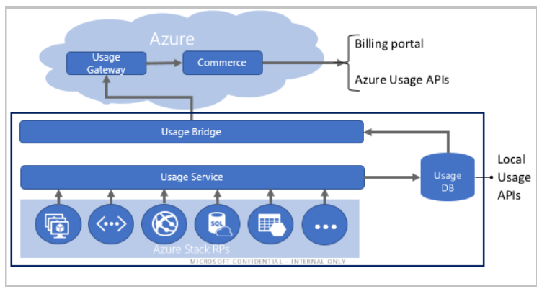
Consumption reporting – usage pipeline

Slide 10
Setting up Billing
Pre-requisites (for multinode):
Azure subscription connected to EA or CSP agreement
Recommendation: have a subscription for each Azure Stack Hub
Register Azure Stack Hub
Registration:
Connects Azure Stack Hub to Azure commerce,
Identifies Azure subscription used for billing
Add-AzsRegistration -CloudAdminCredential $cloudAdminCredential -AzureDirectoryTenantName $azureDirectoryTenantName -AzureSubscriptionId $azureSubscriptionId -PrivilegedEndpoint $privilegedEndpoint -BillingModel PayAsYouUse¹
¹ This registration command will be run as part of the OEM deployment process

Slide 11
Billing for Consumption: Special considerations for CSPs

Slide 12
Azure Stack Hub usage pipeline (for CSPs)
CSP Partner creates CSP subscription for tenant
Standard Partner Center process
CSP Partner onboards tenant to Azure Stack Hub
Tenant obtains local subscription
CSP partner add tenant subscription to registration
Tenant uses Azure Stack Hub resources
Meters are emitted with local Subscription ID
Azure Stack Hub forwards usage meters to Azure
Local subscription replaced with CSP subscription for each tenant
Azure commerce bills CSP, with detail per tenant
(Optional) CSP processes detail for tenant billing
Contoso Offer
Bill
$
$
$
$
$
2AFD8568-8192-4EE6-8883-04A31650D016

Slide 13

For CSPs: Tag your registration for multi-tenant billing
Register your Azure Stack Hub
Send tagging request to AzStCSP@Microsoft.com
Registration name and resource group
Subscription GUID
Microsoft will approve your registration as multi-tenant within the next business day and confirm

Slide 14
Add tenants to CSP registration
Log into Azure (Login-AzureRMAccount) using the tenant that is used for registration.
Update the original registration with a PowerShell command or an API call
# Add new tenant mapping
New-AzureRmResource -ResourceId "subscriptions/{registrationSubscriptionId}/resourceGroups/{resourceGroup}/providers/Microsoft.AzureStack/registrations/{registrationName}/customerSubscriptions/{customerSubscriptionId}" -ApiVersion 2017-06-01 –Properties ""
*We can also move registration between Resource Groups (for all customers) and between subscriptions (for CSPs). When moving between subscriptions, both subscriptions must belong to same partner ID, and all tenant mappings are kept intact.

Slide 15
Viewing and Reporting On Usage Data

Slide 16

Getting usage data from Azure
Portals (Account portal, Partner Center)
Azure reconciliation files
Azure and Azure Stack Hub usage APIs
Powershell usage script

Slide 17
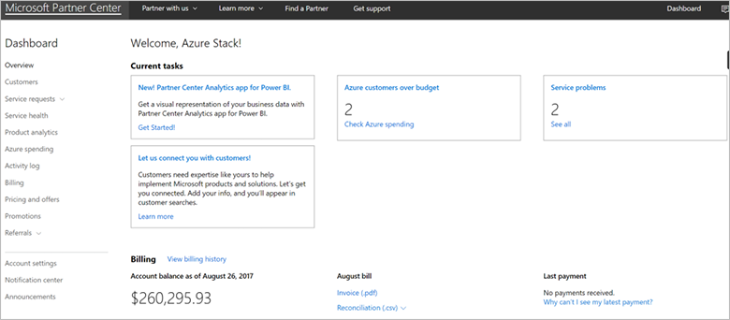
Billing information sources
CSPs use the familiar consumption and invoices processes in Partner Center (example below)
Enterprises see Azure Stack Hub consumption in their EA Portal for Azure
If you registered Azure Stack Hub with a pay-as-you-go subscription, you can see consumption in your Azure Account Center
https://docs.microsoft.com/en-us/azure/azure-stack/azure-stack-usage-reporting

Slide 18
Partner Center - CSP subscriptions
The reconciliation file, downloadable from Partner Center has detailed usage data in it. The AdditionalInfo field has the Azure Stack Hub subscription ID so you can identify the users for each consumed item.
https://docs.microsoft.com/en-us/azure/azure-stack/azure-stack-usage-reporting

Slide 19




How can you review usage data?
If you need data as billed by Azure
Your Azure bill contains the info you need
Use Azure commerce APIs
If you need data from different meters, visibility into usage before billing is available, etc.
Access usage on Azure Stack Hub
Azure
Usage Gateway
Commerce
$
4
5
3
Usage Bridge
2
Usage
DB
Usage Service
1
…
Azure Stack Hub RPs

Slide 20
What data is available? Azure commerce meter examples
Resource GUID | Service Name | Service Type | Resource Name
3e59e16d-a651-4979-a727-423969613c6b | Virtual Machines |  | VM Admin
7bc19779-56bc-474d-8c88-36fbd79ae004 | Virtual Machines |  | VM
d30b4825-579c-4463-a83e-cbd0e04dff81 | Virtual Machines |  | Windows VM Admin
fb8c0713-ea20-40bf-901f-5560fd3f6330 | Virtual Machines |  | Windows VM
0c1fecb6-52d8-4130-bbfa-f79e6a5b056d | Storage | Standard Disks | Storage
44ca5145-137d-4740-9845-b08784206c45 | Storage | Standard Disks | Storage Admin
5849dc2e-ac2e-489f-a53c-b2dfb0f5bdff | Storage | Tables | Storage
5bfe1d6a-bdf3-4cfe-8d36-a1c8e4734921 | Storage | Queues | Storage
8767aeb3-6909-4db2-9927-3f51e9a9085e | Storage | Block Blob | Storage Admin
8a913f38-33b4-4772-9488-e89522fc09e5 | Storage | Block Blob | Storage
8e9d8811-9f3d-4567-8258-0ba581c143b8 | Storage | Queues | Storage Admin
daa83056-2903-4286-826b-564f3037bf61 | Storage | Tables | Storage Admin
190c935e-9ada-48ff-9ab8-56ea1cf9adaa | App Service |  | App
dba5e57a-99ce-4843-b7a6-1d70f36fa1a1 | App Service |  | App Admin
5b1db88a-8596-4002-8052-347947c26940 | Storage | Managed Disks | Std Managed Disk-1024 GB
“Admin” meters will be used for infrastructure ($0 price)
Contact your Microsoft rep for other prices

Slide 21
What data is available? Azure Stack Hub local meters Current full list posted here: https://docs.microsoft.com/en-us/azure-stack/operator/azure-stack-usage-related-faq?view=azs-1908
Resource provider | Meter ID | Meter name | Unit
Network | F271A8A388C44D93956A063E1D2FA80B | Static IP Address Usage | IP addresses
 | 9E2739BA86744796B465F64674B822BA | Dynamic IP Address Usage | IP addresses
Storage | B4438D5D-453B-4EE1-B42A-DC72E377F1E4 | TableCapacity | GB*hours
 | B5C15376-6C94-4FDD-B655-1A69D138ACA3 | PageBlobCapacity | GB*hours
 | 5b1db88a-8596-4002-8052-347947c26940 | S30 | Count of 1024GB Managed Disks*month
 | 09F8879E-87E9-4305-A572-4B7BE209F857 | BlockBlobCapacity | GB*hours
 | B9FF3CD0-28AA-4762-84BB-FF8FBAEA6A90 | TableTransactions | Request count in 10,000's
 | 50A1AEAF-8ECA-48A0-8973-A5B3077FEE0D | TableDataTransIn | Ingress data in GB
 | 1B8C1DEC-EE42-414B-AA36-6229CF199370 | TableDataTransOut | Egress in GB
 | 43DAF82B-4618-444A-B994-40C23F7CD438 | BlobTransactions | Requests count in 10,000's
 | 9764F92C-E44A-498E-8DC1-AAD66587A810 | BlobDataTransIn | Ingress data in GB
 | 3023FEF4-ECA5-4D7B-87B3-CFBC061931E8 | BlobDataTransOut | Egress in GB
 | EB43DD12-1AA6-4C4B-872C-FAF15A6785EA | QueueTransactions | Requests count in 10,000's
 | E518E809-E369-4A45-9274-2017B29FFF25 | QueueDataTransIn | Ingress data in GB
 | DD0A10BA-A5D6-4CB6-88C0-7D585CEF9FC2 | QueueDataTransOut | Egress in GB

Slide 22
What data is available? Azure Stack Hub local meters
Resource provider | Meter ID | Meter name | Unit
SQL RP | CBCFEF9A-B91F-4597-A4D3-01FE334BED82 | DatabaseSizeHourSqlMeter | MB*hours
MySQL RP | E6D8CFCD-7734-495E-B1CC-5AB0B9C24BD3 | DatabaseSizeHourMySqlMeter | MB*hours
Compute | FAB6EB84-500B-4A09-A8CA-7358F8BBAEA5 | Base VM Size Hours | Virtual core hours
 | 9CD92D4C-BAFD-4492-B278-BEDC2DE8232A | Windows VM Size Hours | Virtual core hours
 | 6DAB500F-A4FD-49C4-956D-229BB9C8C793 | VM size hours | VM hours
Key Vault | EBF13B9F-B3EA-46FE-BF54-396E93D48AB4 | Key Vault transactions | Request count in 10,000's
App service | 190C935E-9ADA-48FF-9AB8-56EA1CF9ADAA | App Service | Virtual core hours
 | 67CC4AFC-0691-48E1-A4B8-D744D1FEDBDE | Functions - Compute Requests | 10 Requests
 | 957E9F36-2C14-45A1-B6A1-1723EF71A01D | Shared App Service Hours | 1 hour
 | 539CDEC7-B4F5-49F6-AAC4-1F15CFF0EDA9 | Free App Service Hours | 1 hour
 | 88039D51-A206-3A89-E9DE-C5117E2D10A6 | Small Standard App Service Hours | 1 hour
 | 83A2A13E-4788-78DD-5D55-2831B68ED825 | Medium Standard App Service Hours | 1 hour
 | 1083B9DB-E9BB-24BE-A5E9-D6FDD0DDEFE6 | Large Standard App Service Hours | 1 hour
 | 264ACB47-AD38-47F8-ADD3-47F01DC4F473 | SNI SSL | Per SNI SSL Binding
 | 60B42D72-DC1C-472C-9895-6C516277EDB4 | IP SSL | Per IP Based SSL Binding

Slide 23
Access usage data through PowerShell
See usage folder in GitHub (https://github.com/Azure/AzureStack-Tools)

Slide 24
Sample call to admin usage API
https://{ARM-endpoint}/ subscriptions/{adminSubId}/providers/
Microsoft.Commerce/subscriberUsageAggregates?
reportedStartTime={reportedStartTime}&reportedEndTime={reportedEndTime}&
aggregationGranularity={granularity}&subscriberId={tenantSubId}&api-version=1.0
ReportedStartTime and ReportedEndTime to specify a specific range to retrieve usage
AggregationGranularity can be either Hourly or Daily depending on the use case of the caller
SubscriptionId of the tenant user to receive usage for

Slide 25
{
"id": "/subscriptions/d657c399-e17c-405d-859e-9f2efb6462e5/providers/Microsoft.Commerce/UsageAggregates/Daily_BRSDT_20150515_0000",
"name": "Daily_BRSDT_20150515_0000",
"type": "Microsoft.Commerce/UsageAggregate",
"properties": {
"subscriptionId": "d657c399-e17c-405d-859e-9f2efb6462e5",
"usageStartTime": "2015-05-15T00:00:00+00:00",
"usageEndTime": "2015-05-16T00:00:00+00:00",
"instanceData": "{\"Microsoft.Resources\":{\"resourceUri\":\"/subscriptions/d657c399-e17c-405d-859e-9f2efb6462e5/resourceGroups/moinakrg/providers/Microsoft.Storage/storageAccounts/moinakstorage\",\"location\":\"West US\",\"tags\":{\"department\":\"hr\"}}}",
"meterName": "Storage Transactions (in 10,000s)",
"meterCategory": "Data Management",
"unit": "10,000s",
"meterId": "964c283a-83a3-4dd4-8baf-59511998fe8b",
"infoFields": {
},
"quantity": 9.8390
}
}
Subscription that incurred the usage
When usage happened
Resource that incurred the usage
Usage meter and details
Any additional information
Quantity of usage ($$$)

Slide 26
Third party metering/billing products
Exivity, cloudassert, cloudyn all have add-on tools that can manage consumption and billing in Azure Stack Hub (and Azure)
https://exivity.com/azure-stack
http://www.cloudassert.com/Solutions/Azure-Stack
https://www.cloudyn.com/platforms/platformsazure/

Slide 27
Questions?

Slide 29
Appendix

